Slide 1
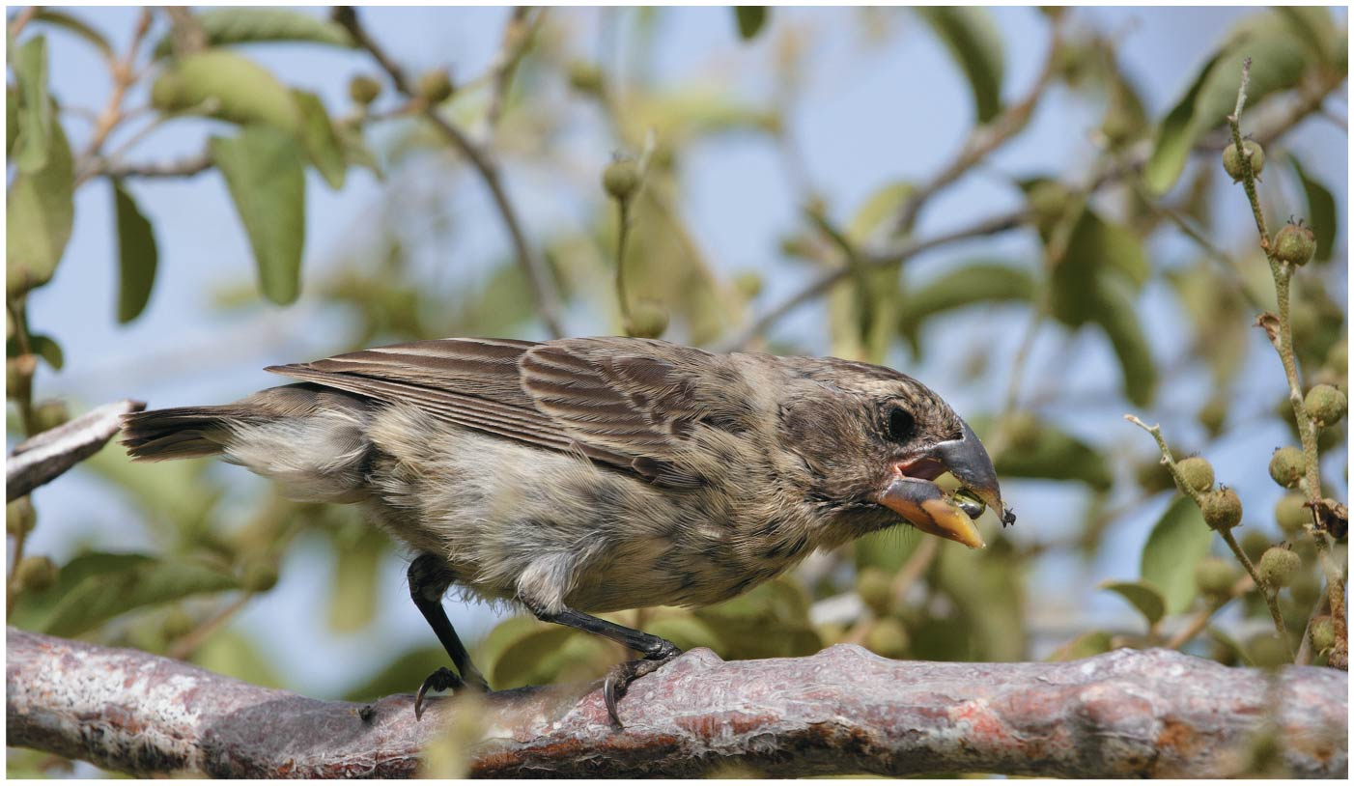
CH 23
LSU BIOL 1202
General Biology II Lecture
CHAPTER 23
The Evolution of Populations
Dr. Adam Hrincevich
Notes:
Figure 23.1 Is this finch evolving?

Slide 2
CH 23 Learning Objectives
Describe how genetic variation arises and explain why it is a prerequisite for evolution.
Use allele-frequency data to predict the genotype frequencies of a population in Hardy-Weinberg equilibrium.
Differentiate between how natural selection, genetic drift, and gene flow affect allele frequencies in a population.
Explain how natural selection can lead to adaptation.
I would suggest completing the crossword puzzle to help you understand the terminology and correlate how the terms relate to topics covered in this chapter.

Slide 3
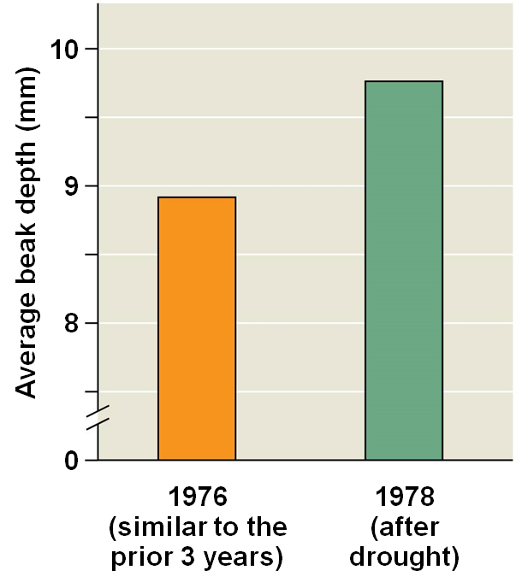
The Smallest Unit of Evolution
A common misconception is that individual organisms
Natural selection acts on individuals, but only
EX: A population of medium ground finches on Daphne Major Island
  During a drought, large-beaked birds were more likely to crack large
So, the finch population evolved, not the

Slide 4
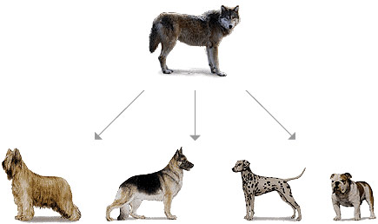
The Smallest Unit of Evolution more
Microevolution is a change in allele frequencies in a population
3 main mechanisms cause allele frequency change:
Only natural selection consistently causes
EX: All modern domestic dogs are descendants of the Gray wolf. Good article about this (click me)

Slide 5
Concept 23.1: Genetic variation makes evolution possible
Genetic variation among individuals is caused by differences in
Variation in heritable traits is a prerequisite for evolution by
Phenotype is the product of inherited genotype and
Some phenotypic differences are determined by a single gene and can be classified on an “either-or” basis
Other phenotypic differences are determined by the influence of two or more genes and vary

Slide 6
Concept 23.1: Genetic variation makes evolution possible cont.
Genetic variation can be measured as gene variability or
For gene variability, average heterozygosity measures the average percent of loci that are
Nucleotide variability is measured by comparing the DNA sequences of
Most differences occur in noncoding regions (introns, ~
Variations that occur in coding regions (exons, ~10% of the human genome) rarely change the amino acid sequence of

Slide 7
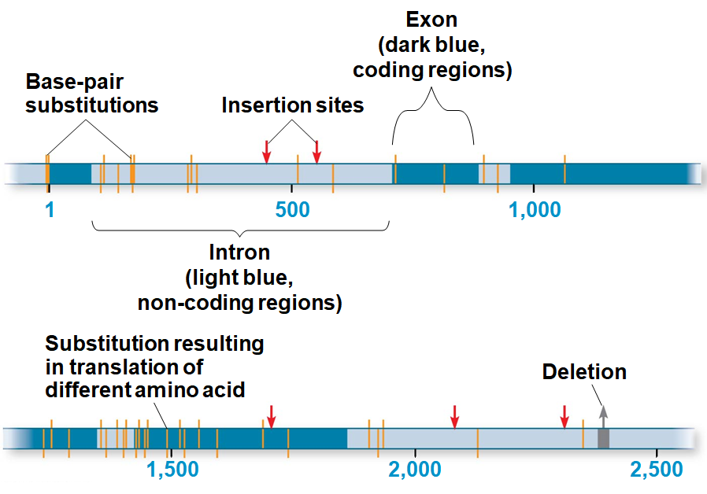
Notes:
Figure 23.4 Extensive genetic variation at the molecular level of the alcohol dehydrogenase (Adh) gene in fruit flies (Drosophilia melanogaster)

Slide 8
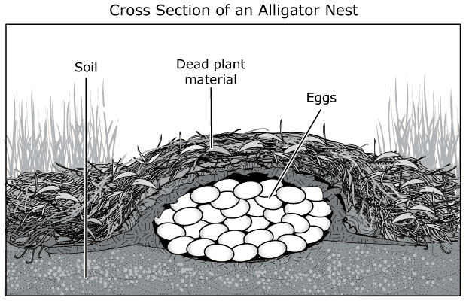
8
Some phenotypic variation does not result from genetic differences among individuals, but rather from
Only genetically determined variation can
The temperature at which alligator eggs develop determines their sex. Eggs hatched between 90◦ F to 93◦ F become MALES, and those hatched between 82◦ F to 86◦ F become FEMALES. Intermediate temperature ranges produces a mix of both male and females.
Notes:
Figure 23.5 Non-heritable variation

Slide 9
Formation of New Alleles
New alleles arise by mutation, a change in the
New genes and alleles can arise by
Sexual reproduction can result in genetic variation by
Only mutations in cells that produce gametes can be
A point mutation is a change in a single nucleotide in a

Slide 10
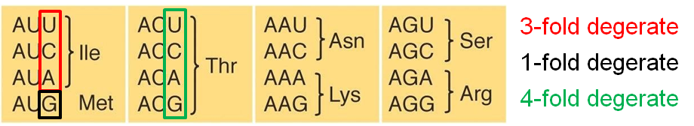
Formation of New Alleles contd.
The effects of
  Mutations that alter the phenotype are
  Harmful mutations can be hidden from selection in
  Mutations that result in a change in phenotype are sometimes,
  Point mutations in non-coding regions (introns) generally result in neutral variation, conferring no selective
  Mutations to genes can be neutral because of

Slide 11
Altering Gene Number or Position
Chromosomal mutations that delete, disrupt, or rearrange
Duplication of small pieces of DNA increases genome
Duplicated genes can take on new functions by
An ancestral odor-detecting gene has been duplicated many times: Humans have 380 copies of the gene, and

Slide 12
Rapid Reproduction
Mutation rates are
The average is about one mutation in every
Mutation rates are often lower in prokaryotes, but short generation times allow
Viruses have both high mutation rates and
  EX: HIV has a

Slide 13
Sexual Reproduction
In organisms that reproduce sexually, most genetic variation results from
Sexual reproduction can shuffle existing alleles into new combinations through three mechanisms
  Crossing over:
  Independent assortment:
  Fertilization:

Slide 14
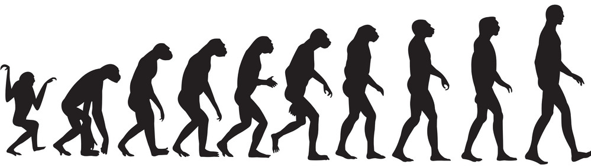
Concept 23.2: The Hardy-Weinberg equation can be used to test whether a population is evolving
Genetic variation is required for a population to evolve, but
One or more factors that cause evolution must be at work for

Slide 15
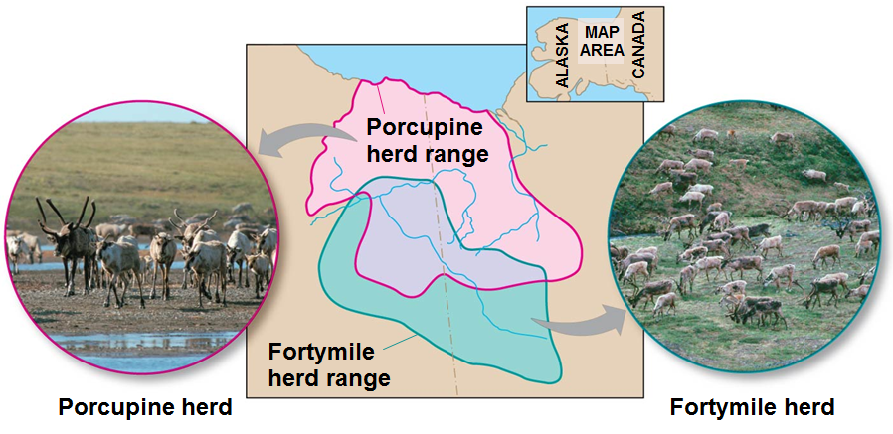
Gene Pools and Allele Frequencies
A population is a localized group of individuals capable of
Populations are not always geographically isolated, but individuals typically only breed with
Notes:
Figure 23.6 One species, two populations

Slide 16
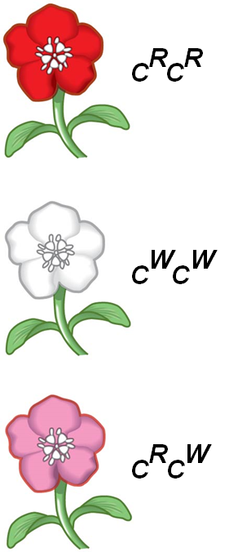
Gene Pools and Allele Frequencies contd.
A gene pool consists of all the alleles for all
A locus is fixed if all individuals in a population are
If there are two or more alleles for a locus, diploid individuals may be either
This example of flower color illustrates INCOMPLETE dominance (or “
Notes:
Figure 23.8c Hardy-Weinberg equilibrium (part 3: alleles showing incomplete dominance)

Slide 17
Gene Pools and Allele Frequencies continued
The frequency of an allele in a population can be calculated
  For diploid organisms, the total number of alleles at a locus is the
  The total number of dominant alleles at a locus is two alleles for each homozygous dominant individual plus one allele for each heterozygous individual; the same logic applies
If there are two alleles at a locus, p and q are used to represent their frequencies (where “p” if the dominant allele and “q” is the recessive allele)
The frequency of all alleles in a population will add up to 1
  So…….

Slide 18
Gene Pools and Allele Frequencies continued more
EX: Wildflowers color is incomepletely dominant
  320 red flowers (C^{R}C^{R})
  160 pink flowers (C^{R}C^{W})
  20 white flowers (C^{W}C^{W})
Calculate the number of copies of each allele
  C^{R} = (320 × 2) + 160 =
  C^{W} = (20 × 2) + 160 =
Calculate the frequency of each allele
  p = frequency of C^{R} = 800/(800 + 200) = 0.8 (80%)
  q = 1 − p = 0.2 (20%)
The sum of alleles is always 1 (100%)
  0.8 + 0.2 = 1.0 (or 100%)

Slide 19
The Hardy-Weinberg Equation
The Hardy-Weinberg (HW) equation describes the genetic makeup we expect for a population that is not
In a population where gametes contribute to the next generation randomly and Mendelian inheritance occurs, allele and genotype frequencies remain constant from
Such a population is in
If the observed genetic makeup of the population differs from expectations under HW, it suggests that the

Slide 20
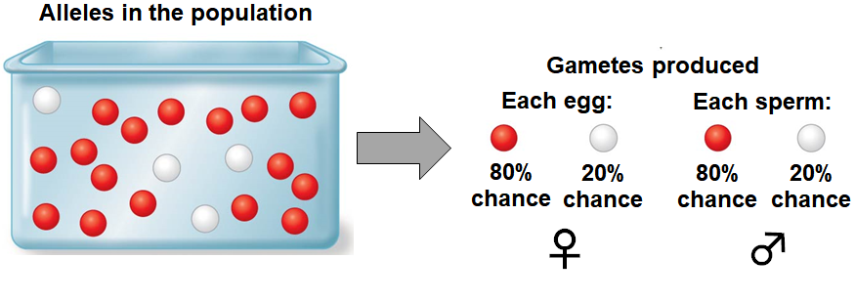
Hardy-Weinberg Equilibrium
HW equilibrium describes the constant frequency of alleles in such a gene pool
Consider, for example, the same population of 500 wildflowers and 1,000 alleles where
  p = frequency of C^{R} (dominant allele) =
  q = frequency of C^{W} (recessive allele) =

Slide 21
HWE
The frequency of genotypes can be calculated
  C^{R}C^{R} = p² = 0.8 × 0.8 =
  C^{R}C^{W} = 2pq = 2 × 0.8 × 0.2 =
  C^{W}C^{W} = q² = 0.2 × 0.2 =
The frequency of genotypes can be confirmed using a

Slide 22
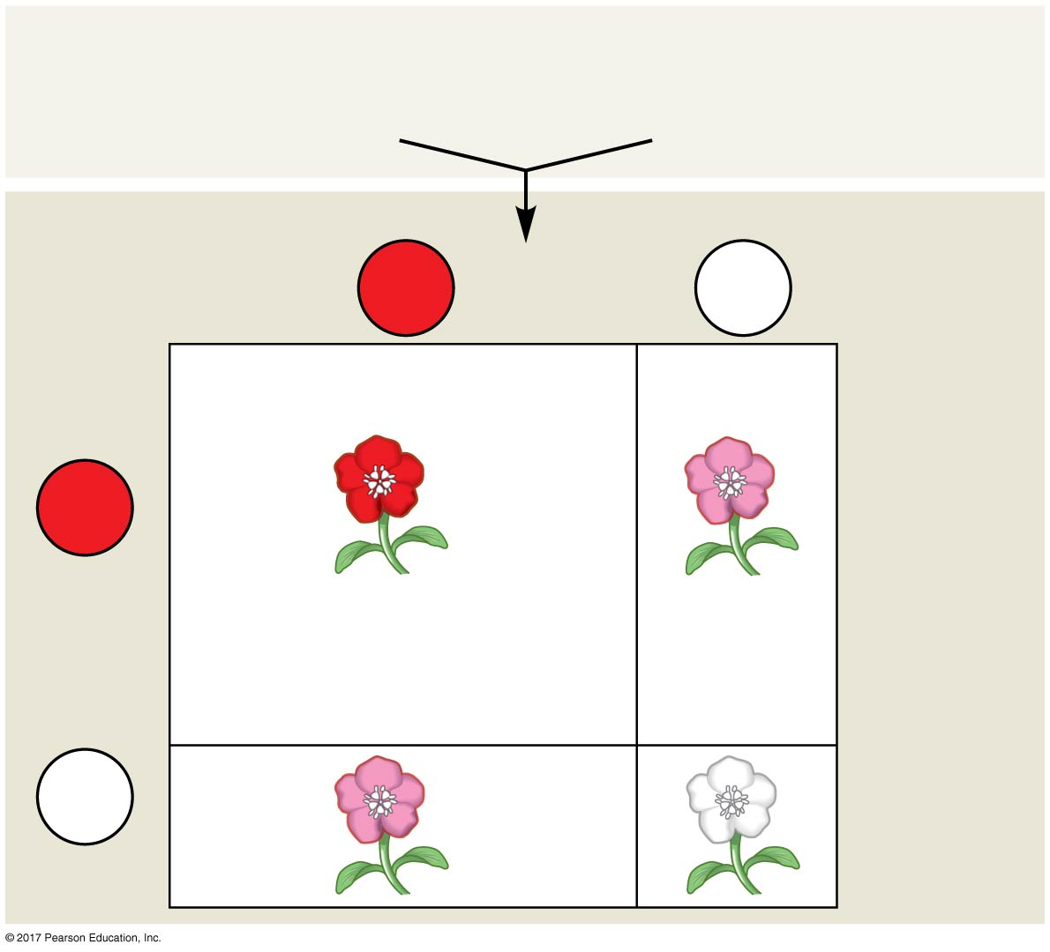
Gene pool of the initial (parental) generation:
80% C^{R} (p = 0.8)
20% C^{W} (q = 0.2)
Sperm
C^{R}
p = 0.8
C^{W}
q = 0.2
64%
16%
C^{R}
p = 0.8
0.64 (p²)
0.16 (pq)
Eggs
C^{R}C^{R}
C^{R}C^{W}
16%
4%
C^{W}
0.16 (qp)
0.04 (q²)
q = 0.2
C^{R}C^{W}
C^{W}C^{W}
Notes:
Figure 23.8a Hardy-Weinberg equilibrium (part 1: Punnett square)

Slide 23
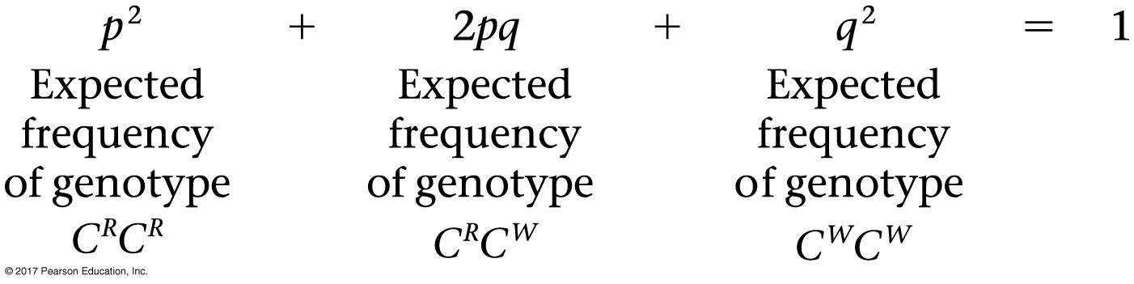
If p and q represent the relative frequencies of the only two possible alleles in a population at a particular locus, then
  p² + 2pq + q² = 1
  p² = frequency of the
  q² = frequency of the
  2pq = frequency of the
Notes:
Figure 23.8d Hardy-Weinberg equilibrium (part 4: Hardy-Weinberg equation)

Slide 24
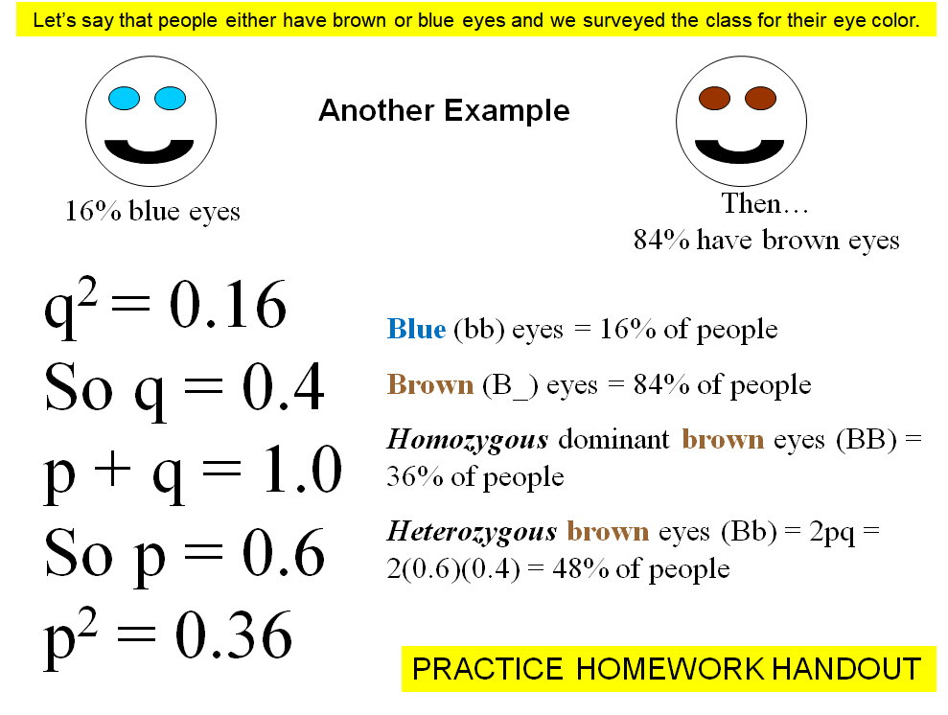
HW problem walk through
0
GRADED HOMEWORK on MOODLE

Slide 25
Conditions for Hardy-Weinberg Equilibrium
The HW approach describes a population that is
In real populations, allele and genotype frequencies often
Changes occur when one or more of the conditions for HW equilibrium are
Natural populations can evolve at some loci while being in HW equilibrium
The HW equation can be used to test whether evolution is
It is also used to determine the percentage of a population

Slide 26
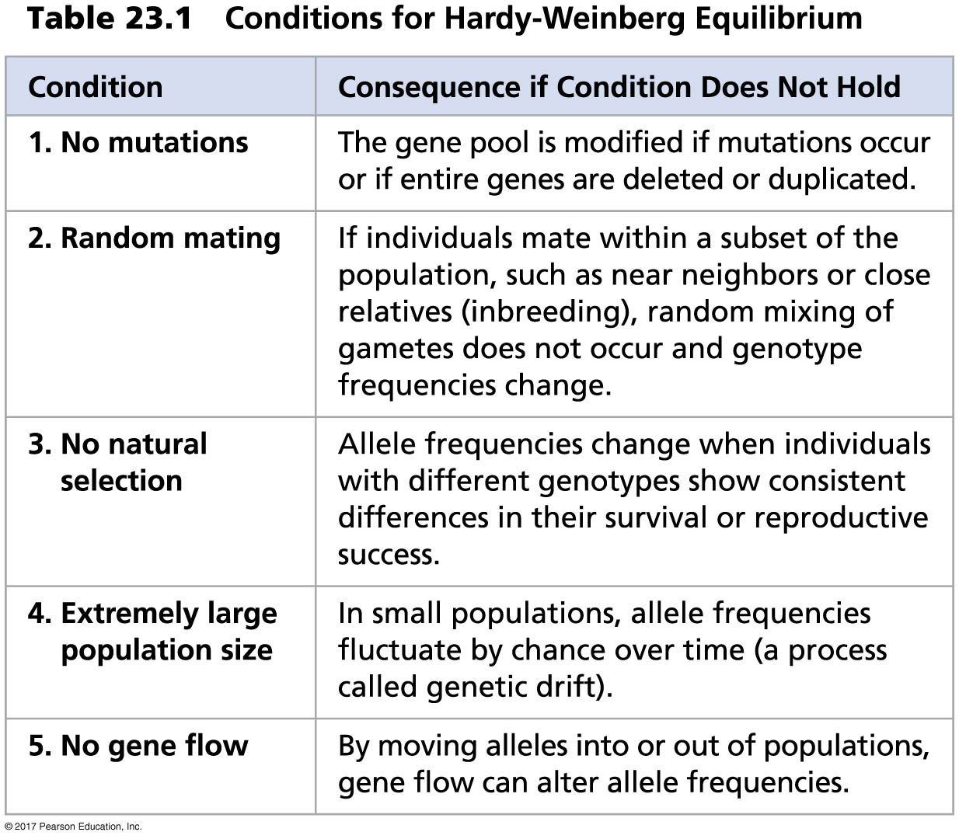
HW conditions needed
KNOW THESE FOR THE EXAM
Notes:
Table 23.1 Conditions for Hardy-Weinberg equilibrium

Slide 27
PKU example
EX: We can assume that the locus that causes phenylketonuria (PKU) is in HW equilibrium because:
PKU is caused by a defect in a gene that helps create the enzyme needed to break down the amino acid
  The PKU gene
  Mate selection is random with respect to whether or not an individual is a
  Natural selection can only act on rare homozygous individuals who do not
  The population is
  Migration has no effect, as many other populations have

Slide 28
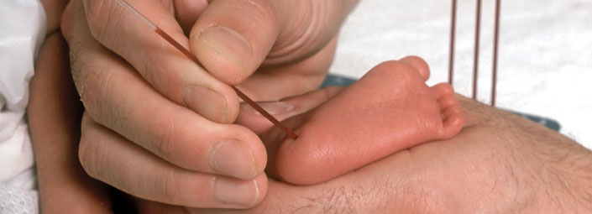
PKU example more
The occurrence of PKU is one per 10,000 births
  q² = 0.0001, so q =
The frequency of normal alleles is
  p = 1 – q = 1 − 0.01 =
The frequency of carriers is
  2pq = 2 × 0.99 × 0.01 =
  or approximately
The blood sample for PKU is usually taken from a baby's heel (called a heel stick).
Notes:
All 50 states in the United States require newborns to be screened for PKU . Many other countries also routinely screen infants for PKU

Slide 29
Concept 23.3: Natural selection, genetic drift, and gene flow can alter allele frequencies in a population
Three major factors alter allele frequencies and bring about most evolutionary change:

Slide 30
1. Natural Selection
Selection results in alleles being passed to the next generation in proportions that differ from
EX: An allele that confers resistance to DDT in fruit flies increased in frequency after
Natural selection can cause adaptive evolution, a process in which traits that enhance survival or reproduction

Slide 31
2. Genetic Drift
The smaller a sample, the greater the chance of random
Genetic drift describes how allele frequencies fluctuate unpredictably from
Genetic drift tends to reduce genetic variation through the
Two main types of genetic drift

Slide 32





Size of the population
is very important…
Hey, can I borrow $5?
50% of net worth
5% of net worth
0.5% of net worth
$10
$100
$1000

Slide 33
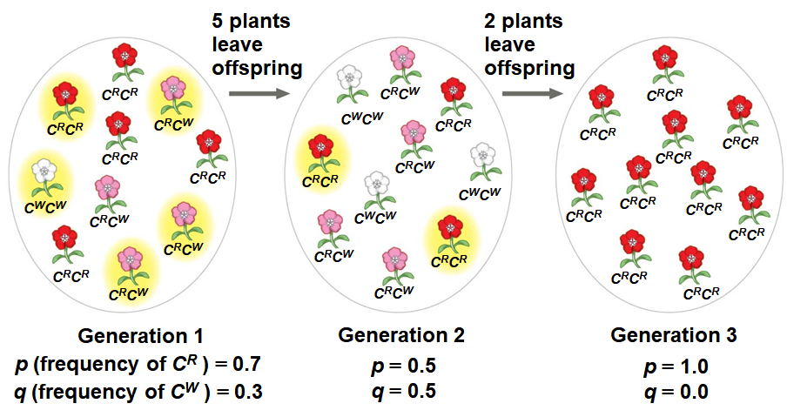
Genetic Drift Overall Process
Notes:
Figure 23.9_3 Genetic drift

Slide 34
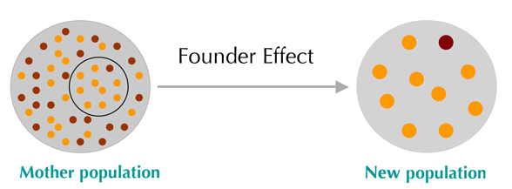
Founder Effect
The founder effect occurs when a few individuals become isolated from a larger population or
Allele frequencies in the small founder population can be different from

Slide 35
Bottleneck Effect
The bottleneck effect occurs when there is a drastic reduction in population size due to
The resulting gene pool may no longer be reflective of the
If the population remains small, it may be further affected by
Understanding the bottleneck effect can increase understanding of how

Slide 36
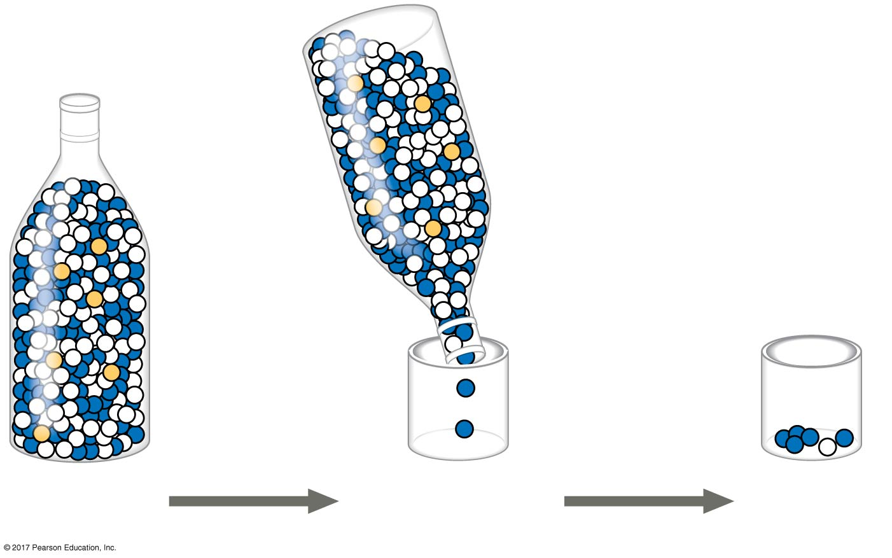
Original
population
Bottlenecking
event
Surviving
population
Notes:
Figure 23.10_3 The bottleneck effect

Slide 37
Effects of Genetic Drift: A Summary
Genetic drift is
Genetic drift can cause allele frequencies to
Genetic drift can lead to a
Genetic drift can cause

Slide 38
3. Gene Flow
Consists of alleles moving
Alleles can be transferred through the movement of fertile individuals or
Gene flow can reduce population variation over time and
EX: Spread of alleles for
  Insecticides have been used to target mosquitoes that carry
  Alleles for resistance have
  Resistance alleles can
Gene flow is an important agent of evolutionary change in

Slide 39
Concept 23.4: Natural selection is the only mechanism that consistently causes adaptive evolution
Evolution by natural selection involves both chance and “
  New genetic variations arise
  Beneficial alleles are “sorted” and favored by
Only natural selection consistently increases the frequencies of alleles that provide
Natural selection brings about adaptive evolution by acting on

Slide 40
Relative Fitness
The phrases “struggle for existence” and “survival of the fittest” are misleading, as they imply
Reproductive success is generally more
Relative fitness is the contribution an individual makes to the gene pool of the next
  Higher fitness values = favored by natural selection, tend to
  Lower fitness values = natural selection is removing it from the population at a faster rate, tend to

Slide 41
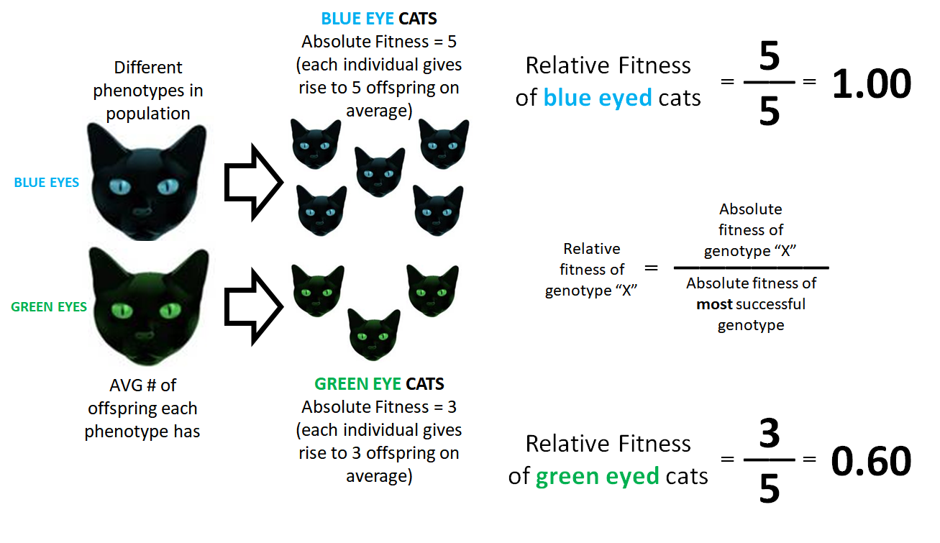
EXAMPLE 1: Calculation of Relative Fitness

Slide 42
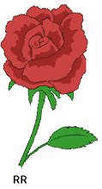

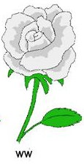
EXAMPLE 2: Calculation of Relative Fitness With Probability of Factored In
 | RED ROSES | PINK ROSES | WHITE ROSES
Probability of Survival | 90.0% | 85.0% | 80.0%
Number of Offspring | 3 | 4 | 5
Absolute Fitness | (0.90 * 3) = 2.70 | (0.85 * 4) = 3.40 | (0.80 * 5) = 4.00
Relative Fitness | 2.70/4.00 = 0.68 | 3.40/4.00 = 0.85 | 4.00/4.00 = 1.00
Relative fitness = absolute fitness of genotype “X” / absolute fitness of most successful genotype

Slide 43
Directional, Disruptive, and Stabilizing Selection
There are three modes of selection:
  Directional selection favors individuals at one
  Disruptive selection favors individuals at
  Stabilizing selection favors intermediate variants and acts

Slide 44
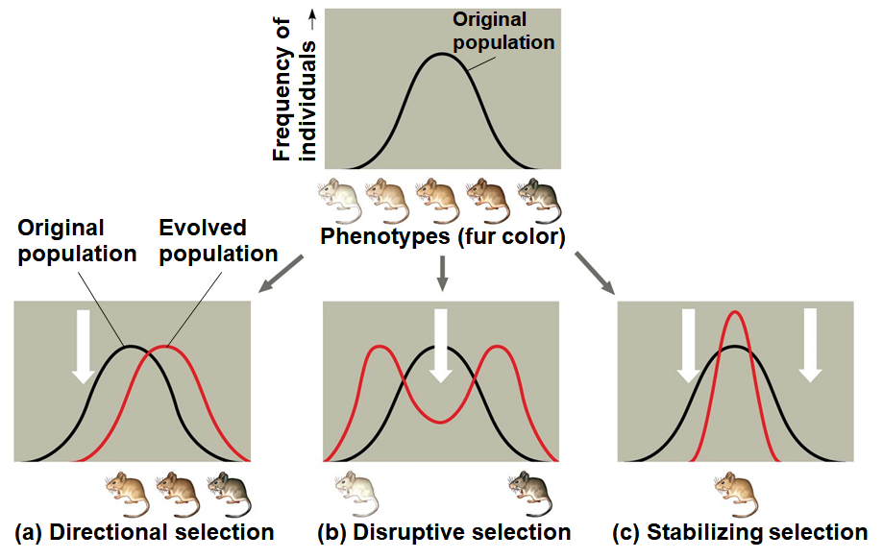
Notes:
Figure 23.13 Modes of selection

Slide 45
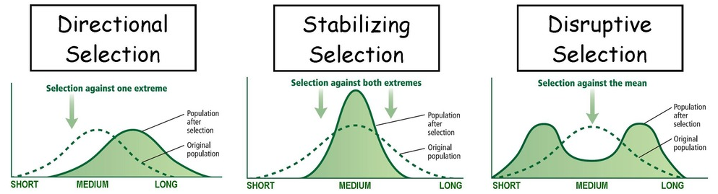
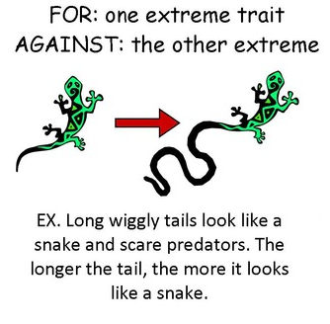
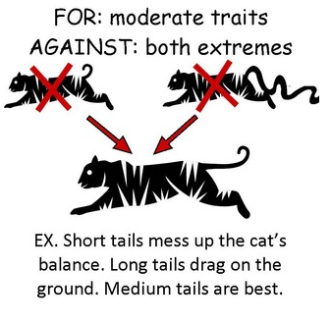
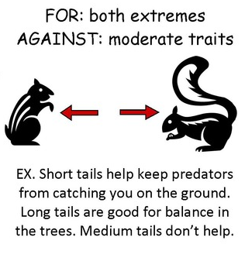
3 examples…

Slide 46
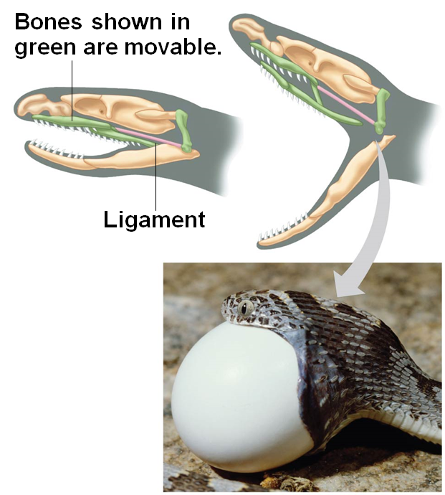
The Key Role of Natural Selection in Adaptive Evolution
Striking adaptations have arisen by
  EX: certain octopuses can change
  EX: the jaws of snakes allow them to
Because the environment can change, adaptive evolution is
Notes:
Figure 23.14 Movable jaw bones in snakes

Slide 47
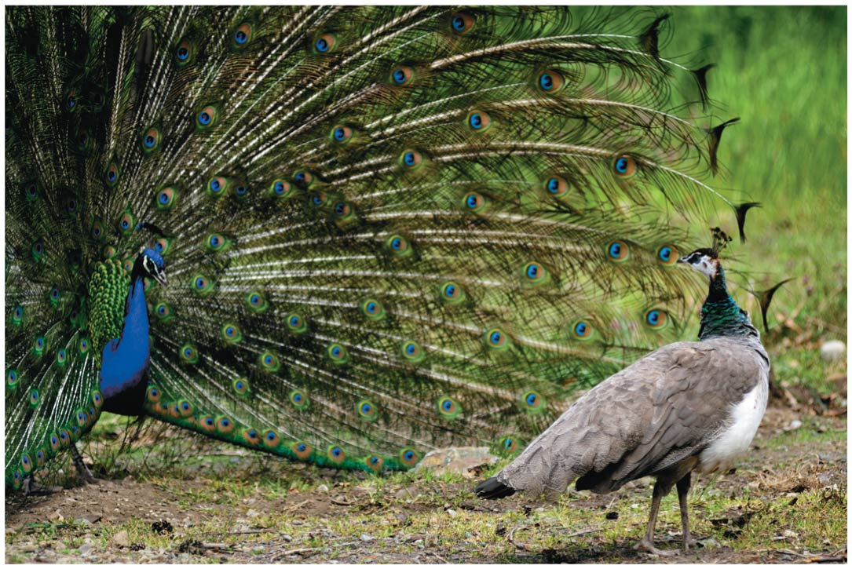
Sexual Selection
Process in which individuals with certain inherited characteristics are more likely to acquire mates than other
It can result in sexual dimorphism, marked differences between the sexes in
Male
Female
Notes:
Figure 23.15 Sexual dimorphism and sexual selection

Slide 48
Sexual Selection more
Intra-sexual selection is direct competition among individuals of one sex (often males) for
Inter-sexual selection, often called mate choice, occurs when individuals of one sex (usually females) are
Showiness of male appearance can increase a male’s chances of attracting a female while decreasing
How do female preferences evolve?
The “good genes” hypothesis suggests that if a trait is related to male genetic quality, both the male trait and female preference for that trait should

Slide 49
Balancing Selection
Diploidy maintains genetic variation in the form of recessive alleles hidden from
Balancing selection occurs when natural selection maintains stable frequencies of two or more
Balancing selection includes

Slide 50
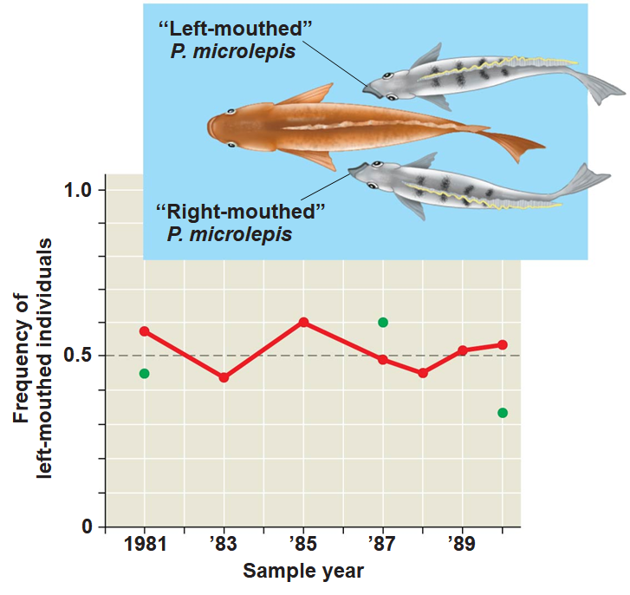
Frequency-Dependent Selection
In frequency-dependent selection, the fitness of a phenotype depends on
EX: frequency-dependent selection results in approximately equal numbers of “right-mouthed” and “left-mouthed”

Slide 51
Heterozygote Advantage
Heterozygote advantage occurs when heterozygotes have a higher
Natural selection will tend to maintain two or more
Heterozygote advantage can result from stabilizing or
A mutation in an allele that codes for part of the hemoglobin protein causes sickle-cell disease, but also
In regions where the malaria parasite is common, selection favors individuals

Slide 52
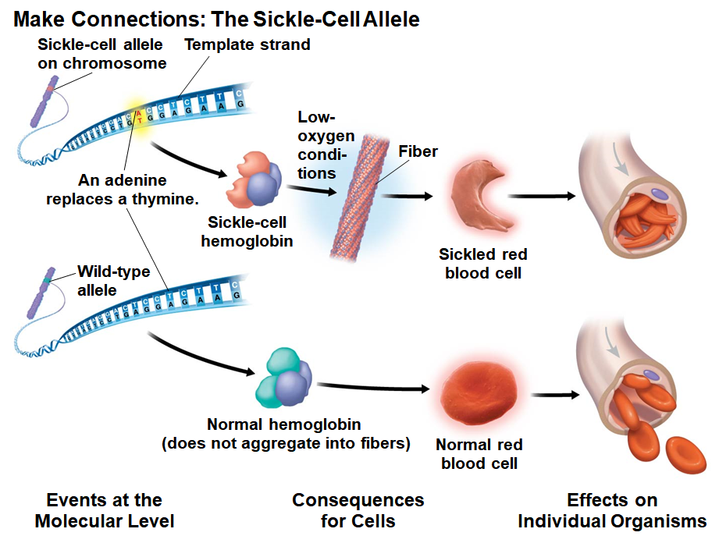
Notes:
Figure 23.18a Make connections: the sickle-cell allele (part 1: molecular events and consequences)

Slide 53
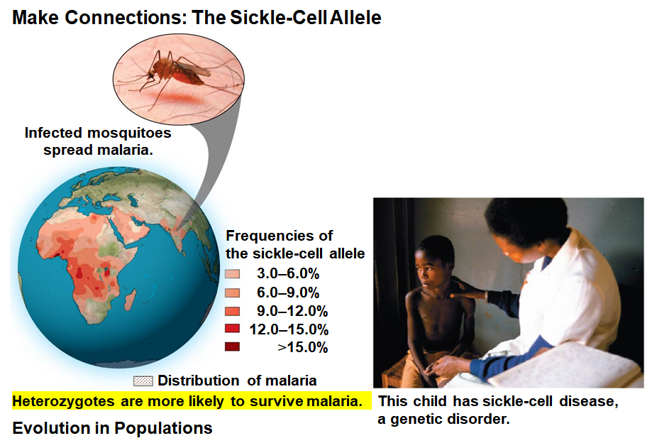
New treatment: CLICK ME!

Slide 54
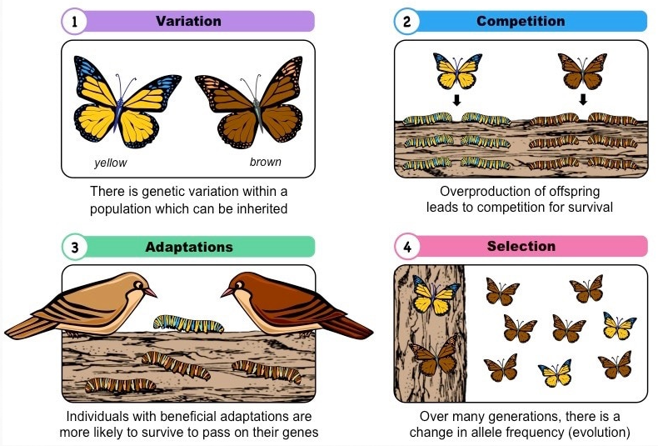
Why Natural Selection Cannot Fashion Perfect Organisms
Selection can act
Evolution is
Adaptations are
Chance, natural selection, and

